Slide 1
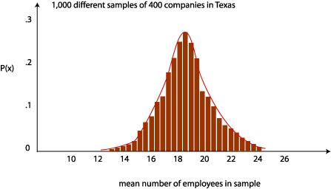
Week 6: Central limit theorem and CIs
Geog4300: Shannon

Slide 2
This week
Z/t scores
Central limit theorem
Confidence intervals
Sampling

Slide 3
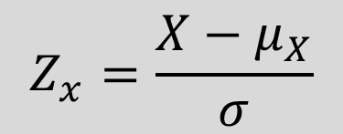

Z (and t) scores
How many standard deviations is an observation from the mean?
For a variable with a mean of 23 and a s.d. of 4, the z-score for 30 would be:
$$\frac{30 −23}{4}=1.75$$
What value would produce a z-score of negative 2?

Slide 4
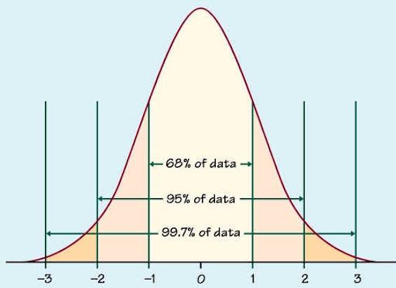
Z (and t) scores: Why do they matter?
They provide an easy way to compare data from different distributions (e.g. daytime and nighttime temperatures)
In a normal distribution, we can identify what percentage of observations fall within given Z scores.
Z score of 1: 68% of observations
Z score of 1.75: 90% of observations
Z score of 1.96: 95% of observations

Slide 5
Data challenge!
Pick a variable from our county census dataset. Transform its values to z-scores. How many counties are above 2? How many below -2? In what states/regions are these located?

Slide 6

The central limit theorem:
What’s the relationship between the mean of the sample population and the actual population?

Slide 7
Let’s roll!
Roll your dice 10 times. Put the results on this page:
https://bit.ly/geog4300_dice
Then do two more sets of 10 rolls (30 total rolls)

Slide 8
Identifying our terms
Samples: Each individual set of 10 dice rolls
Sample mean distribution: The class set of means from our 10 dice rolls
Population: All possible sets of 10 dice rolls

Slide 9
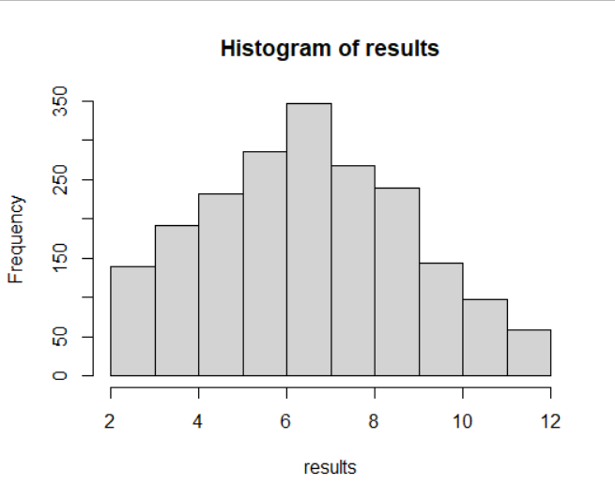

What’s the mean of the population?
Mean of two dice rolls: 7
Standard deviation: 2.4
How did your three “samples” compare?
Calculate the Z score of each sample:
$$\frac{Mean of your 10 rolls −7}{2.4}$$
Histogram of results from 2,000 simulated two dice rolls.

Slide 10
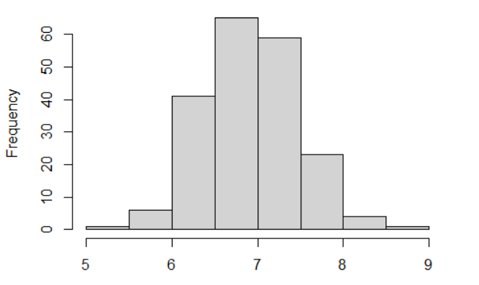

Central limit theorem: The distribution of sample means is normally distributed and centers around the population mean.
The actual mean is here somewhere!

Slide 11
What’s the mean and standard deviation for our whole class’s rolls (the sample mean distribution)?
Histogram of means from 200 simulations of 20 two-dice rolls.
Mean of these means: 7
Standard deviation of these means: 0.55

Slide 12


Standard error
$$σ_{\overline{x}}=\frac{σ}{\sqrt{n}}$$
How many 10 dice roll samples did we create? What should our standard error be?
How many means fit within 1 standard error of the mean? Within 2 standard errors?
$σ$=standard deviation of sample or population

Slide 13
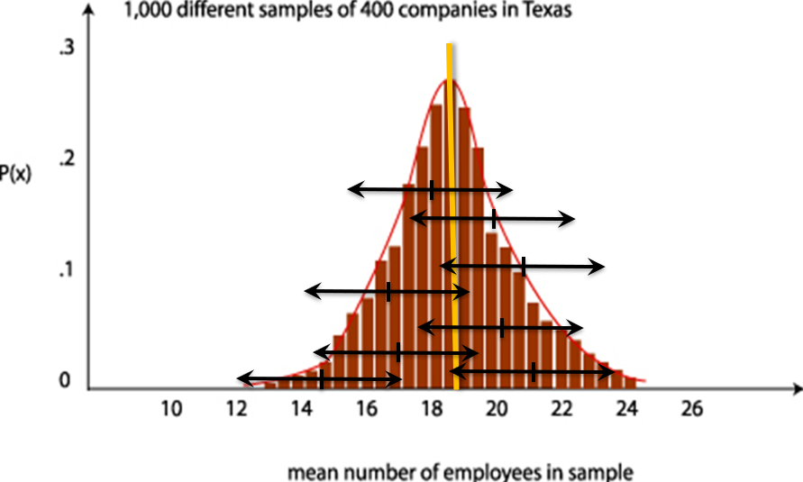
Confidence intervals

Slide 14

Confidence intervals
Three ingredients for a confidence interval:
Sample mean
Standard error
Z-score for the confidence interval
Margin of error = z-score * the standard error
Subtract and add this MOE to the sample mean
What’s the confidence interval for each of your three dice roll samples? How many include the actual mean of 7?
$$σ_{\overline{x}}=\frac{σ}{\sqrt{n}}$$

Slide 15
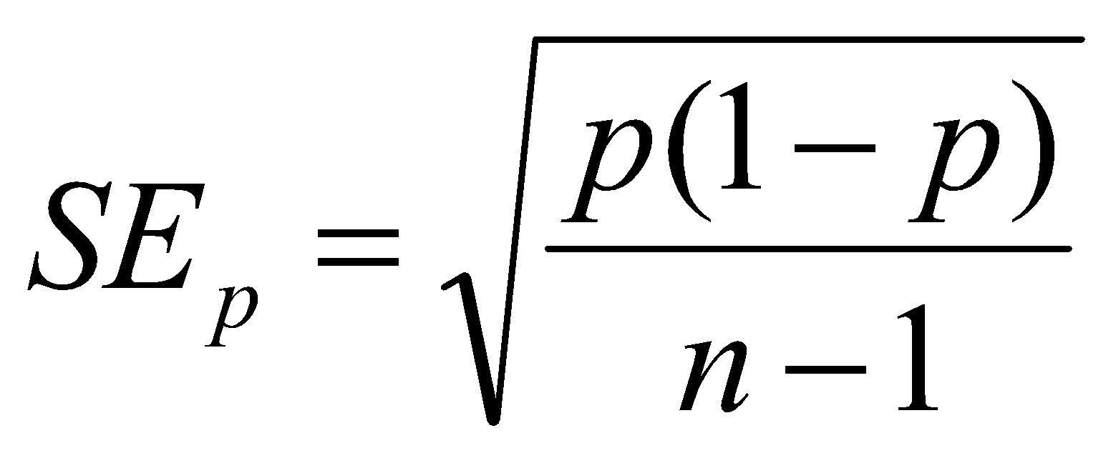

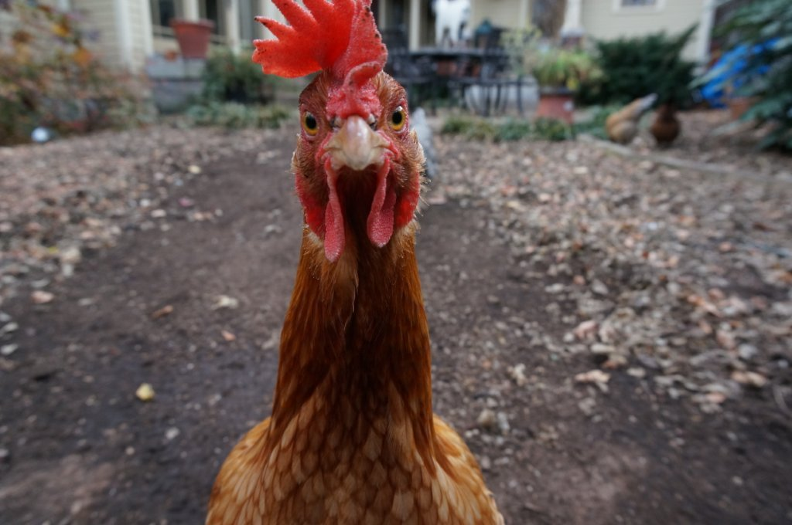
Confidence intervals for proportions
You asked 50 households in Athens if they keep chickens on their property. Three said they did. Create a confidence interval for the proportion of chicken owning households in the city.

Slide 16

Let’s talk about sampling!

Slide 17

Sample research question:
What are the most significant obstacles homeowners face in maintaining their homes? How does this vary by the homeowners’ age?

Slide 18
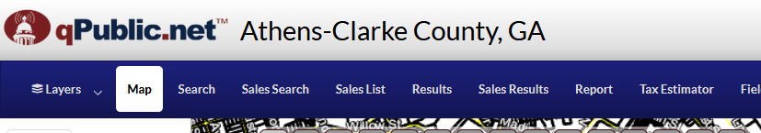
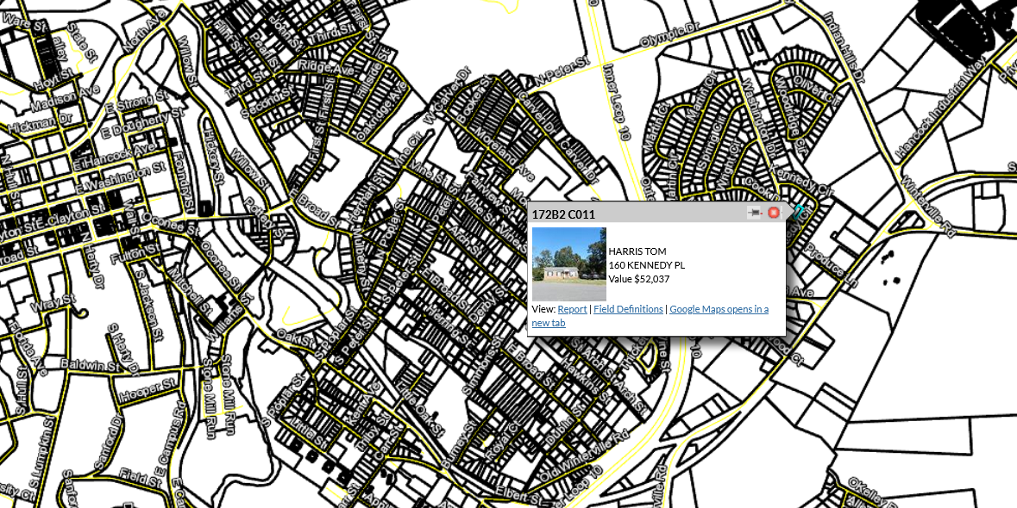
Sampling frame:
List of ALL possible households you could interview

Slide 19
Sampling strategy
Non-probability sample Convenience
Snowball
Quota
Probability sample
Random
Systematic
Stratified
Cluster

Slide 20

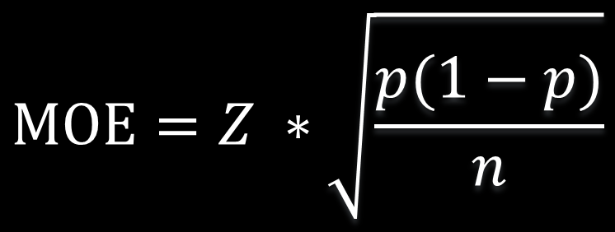
Sample size
$$MOE=Z ∗\sqrt{\frac{p(1−p)}{n}}$$
If the MOE for proportions is
Then we can compute sample size as
$$n=\frac{Z^{2}}{{MOE}^{2}}∗(p ∗\left(1−p\right))$$
We asked 20 homeowners if they were worried about losing their homes in the next year. Four said yes. What’s the confidence interval?
How big a sample would we need to get a margin of error of less than 1.5%?

